Slide 1
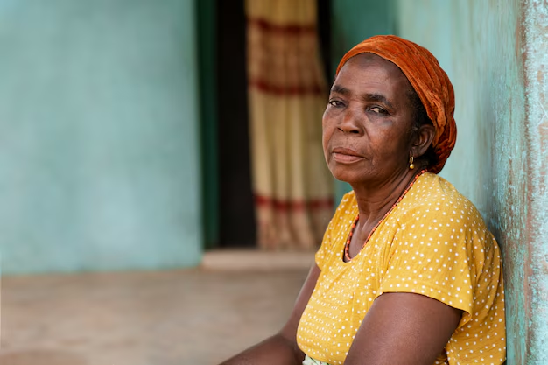
CHANGING THE WORLD OF FINANCE
FinTech For
Kenyan Women

Slide 2
Bridging the Credit Gap for Women-Led Microenterprises in Kenya
● Millions of women-led micro and small enterprises (MSEs) in Kenya remain financially excluded due to limited access to formal credit and digital financial tools.
● Empowering these women financially is critical to achieving inclusive economic development and gender equality.

Slide 3

My Mission: Empowering Women Through Inclusive Technology
Growing up in Kenya, I saw firsthand how many talented women with brilliant business ideas struggled to access credit or financial services simply because they lacked formal documentation or collateral. This shaped my passion for using technology to level the playing field

Slide 4
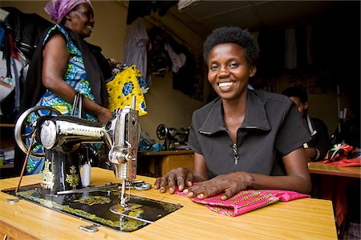
Meet Aisha: A Resilient Entrepreneur Held Back by Financial Exclusion
Aisha is a 34-year-old mother of three who runs a small tailoring shop in Makueni, Kenya. She dreams of expanding her business by buying more sewing machines and hiring two young women from her community.
Despite her strong work ethic and steady stream of customers, Aisha has never qualified for a bank loan. She lacks formal financial records, and she struggles with navigating complex loan application processes. Mobile lending apps offer high interest rates and little flexibility.
Her story is not unique; it represents thousands of women entrepreneurs across Kenya.

Slide 5
Research Objectives
To explore the effectiveness of digital financial tools in improving credit access for informal women entrepreneurs.
To identify social, cultural, and economic barriers that limit women’s adoption of fintech solutions in Kenya.
Research Questions
What digital financial technologies have been most effective in improving access to credit for informal women-led microenterprises in Kenya and similar regions?
How do cultural norms and household power dynamics influence women’s access to and control over digital financial services?
Research Plan
My research includes analyzing reports from fintech providers, government agencies, and NGOs; conducting surveys and interviews with women entrepreneurs; and reviewing academic and policy literature to assess the broader ecosystem and successful interventions.
Researching Financial Exclusion Among Women Entrepreneurs

Slide 6
According to the International Finance Corporation (IFC), over 80% of women-owned micro and small enterprises (MSEs) in Kenya operate informally, making it difficult for them to access traditional bank loans that require formal registration and credit history.
Over 80% of Women-Owned Businesses in Kenya Are Informal
This informality traps women in a cycle of limited growth and vulnerability to economic shocks.
Source: IFC, "Investing in Women: New Evidence for the Business Case," 2021.

Slide 7
$2 Billion Credit Gap for Women-Led MSEs in Kenya
The estimated credit gap for women-led MSEs in Kenya is over $2 billion, leaving a significant portion of the economy underfunded and under-leveraged.
This lack of access to affordable financing prevents women entrepreneurs from scaling their businesses and creating jobs.
Source: McKinsey & Company, "Advancing Women’s Equality in Africa," 2019.

Slide 8
While over 96% of Kenyan adults have access to mobile money services like M-PESA, only 17% of women entrepreneurs report having ever received a loan from a formal financial institution.
ts.
Mobile Money is Widespread, But Credit Access Remains Low
This highlights the need for more inclusive, innovative credit solutions built on platforms women already use.
Source: FinAccess Household Survey, Central Bank of Kenya, 2021.

Slide 9
PROBLEM DISAGGREGATION
a. Structural Barriers – Lack of collateral, formal credit history, and business registration.
b. Technological Gaps – Limited integration of digital lending tools tailored to women’s needs.
c. Socio-Cultural Constraints – Gender norms limiting women’s financial autonomy and digital literacy.
d. Institutional Shortcomings – Inadequate financial products, risk-averse lenders, and weak policy enforcement.
Breaking It Down with the McKinsey Problem-Solving Framework
PRIORITIZATION
Focus on fintech-enabled alternative credit scoring and community-based financial education as key leverage points.
HYPOTHESIS-DRIVEN RESEARCH
Assume that digital tools with alternative scoring models and culturally aware outreach can expand women’s access to credit.

Slide 10
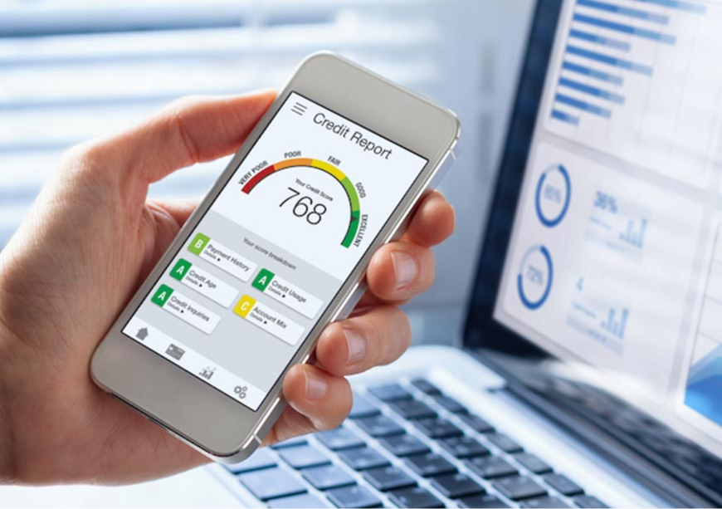
Solution 1: AI-Driven Credit Scoring for Informal Women Entrepreneurs
Develop and pilot an AI-powered alternative credit scoring system that analyzes non-traditional data—like mobile money transactions, airtime top-ups, and inventory purchases—to assess loan eligibility.
This system can be deployed via a mobile app and integrated with fintech platforms like M-PESA and digital wallets.

Slide 11

Solution 2: Digital Financial Literacy Toolkit via WhatsApp Bot
Launch a WhatsApp chatbot that delivers interactive, localized financial education modules in English and Swahili. Topics include budgeting, digital savings, borrowing, and fraud prevention.

Slide 12
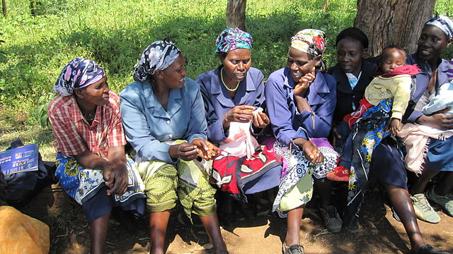
Solution 3: Gender-Inclusive Community Lending Circles with Mobile Integration
Digitize and formalize women’s table banking groups (chamas) by providing a mobile platform to manage group savings, contributions, and loans transparently—while also feeding data into formal credit systems.

Slide 13
User Story: AI Credit Scoring for Informal Women Entrepreneurs
User Story
As a woman running a small informal business in Nairobi, I want to access a loan using my mobile money transaction history so that I can grow my business without needing formal credit records or collateral.
Acceptance Criteria
The mobile app must allow users to register and consent to share mobile money and airtime usage data within 10 minutes.
Users should receive an automated credit score based on their mobile data within 24 hours of registration.
At least 80% of users with a “low-risk” score should be approved for loans from partnered micro-lenders within 7 days.
The app must have a chatbot to help users understand their credit score and how to improve it, with at least 70% of users reporting comprehension in follow-up surveys.
The pilot should enroll at least 10,000 users and issue loans to at least 3,000 within the first year of launch.

Slide 14

Key Performance Indicators (KPIs) for AI Credit Scoring Solution
Loan Approval Rate
User growth rate
Credit Score Accuracy & Default Rate
Loan Disbursement Volume
User Satisfaction Score

Slide 15

My Mission, My Solution
My personal mission is to use technology to unlock economic empowerment for underrepresented communities—especially women in Africa—by improving their access to financial tools, education, and opportunities. I believe no woman should be held back by a lack of formal credit history or financial documentation

Slide 16
Appendix 1
Additional Data on Financial Inclusion in Kenya:
According to the Central Bank of Kenya (2023), over 75% of Kenyan adults have access to mobile money services, yet nearly 60% of small informal businesses lack formal credit access. This gap highlights the opportunity for alternative credit scoring methods to bridge financing for informal entrepreneurs.
Source: Central Bank of Kenya, Financial Inclusion Report, 2023.
2. Successful Related Solutions:
The M-Shwari platform in Kenya has demonstrated how mobile banking and digital credit can empower low-income users by offering instant microloans based on mobile money usage patterns. Adapting similar technology with AI-enhanced scoring can increase accuracy and reach more underserved women entrepreneurs.
Source: FSD Kenya, “Digital Credit in Kenya: Impact and Opportunities,” 2022.

Slide 17
Appendix 2
Target Demographic:
Women informal entrepreneurs in urban and peri-urban Nairobi, aged 18-45, who run small businesses such as market stalls, food vending, tailoring, and hair salons.
User Persona:
Name: Amina
Age: 32
Occupation: Market vendor selling fresh produce in Nairobi’s Gikomba Market
Challenges: Limited access to formal loans due to no credit history or collateral; relies heavily on mobile money for business transactions; needs capital to expand stock and improve income.
Goals: To secure affordable loans quickly and grow her business sustainably without lengthy paperwork or bank visits.
Technology Use: Comfortable with smartphones and mobile money apps but unfamiliar with formal banking systems.

